Slide 1








Slide 2
Music Recommender System

Slide 3
About Team
Background (B-tech or M-tech)
Team Members:
Aditi (M.Sc.(operation research)
Jairaj kumar (B.Tech)
Manjeet Yadav (B.Tech)
Pulkit Agarwal (B.Tech)
Rudrani mondal (b.Tech)
Why do we want to learn Data Science
We want to learn Data Science because its interesting and trending.
Data science has a huge impact on various sectors of development.
Any work experience
Aditi(No work experience)
Jairaj Kumar (No work experience)
Manjeet Yadav(No work experience)
Pulkit Agarwal(No work experience)
Rudrani mondal(No work experience)
What do we like about Innomatics Research lab
Innomatics Research lab is very well established and is very interactive .
The mentors, here, are very supportive and encouraging . The knowledge gained here during this internship is vast and is helping us understand the need to evolve with good ideas shaping our future.
we, heartily thank Innomatics Research labs for providing us with this opportunity.
we thank the mentors for helping us all the time.

Slide 4
What are Recommendations?
How does youtube know what video you might want to watch next? How does the google play store pick an app just for you? magic? No, in both cases, an ml-based recommendation model determines how similar videos and apps are to other things you like and then serves up a recommendation. Two kinds of recommendations are commonly used:
Home page recommendations
Related item recommendations

Slide 5
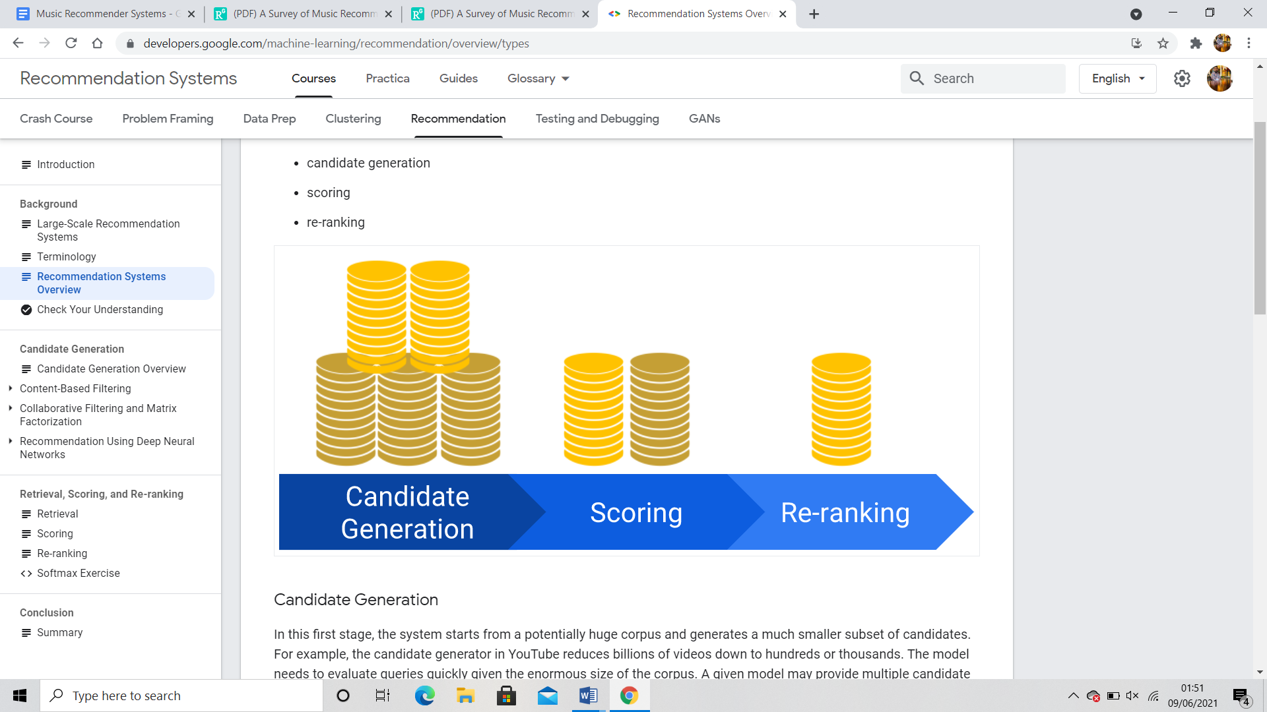
Recommendation Systems Overview
One common architecture for recommendation systems consists of the following components:
candidate generation
scoring
re-ranking

Slide 6
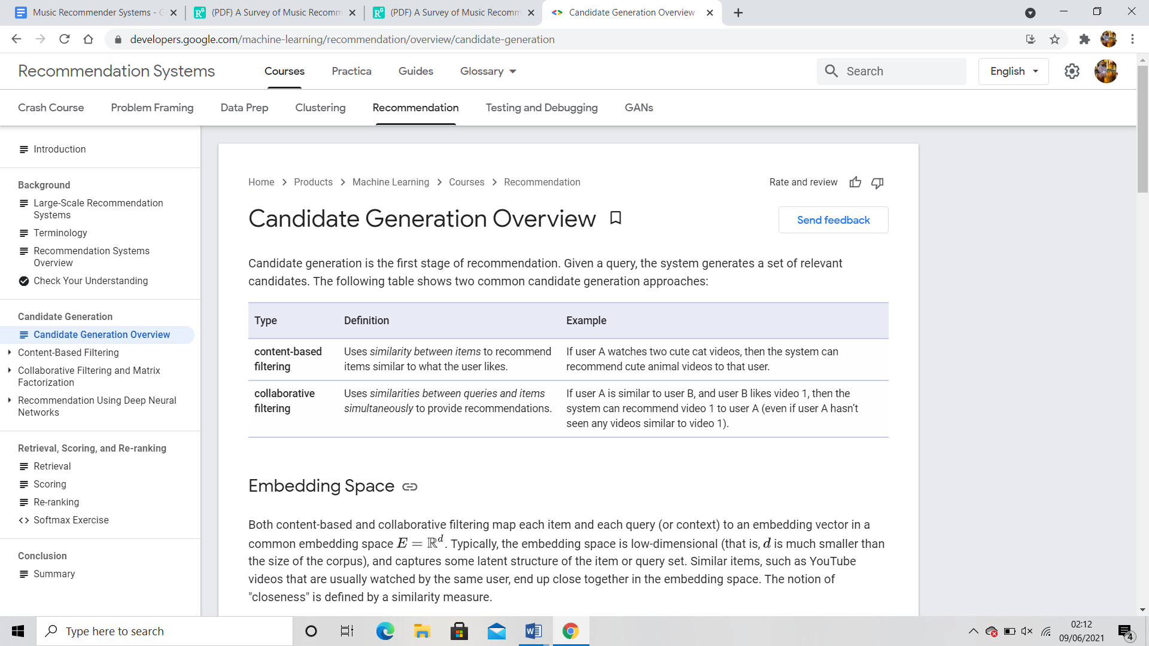
Candidate Generation Overview
Candidate generation is the first stage of recommendation. Given a query, the system generates a set of relevant candidates. The following table shows two common candidate generation approaches:

Slide 7
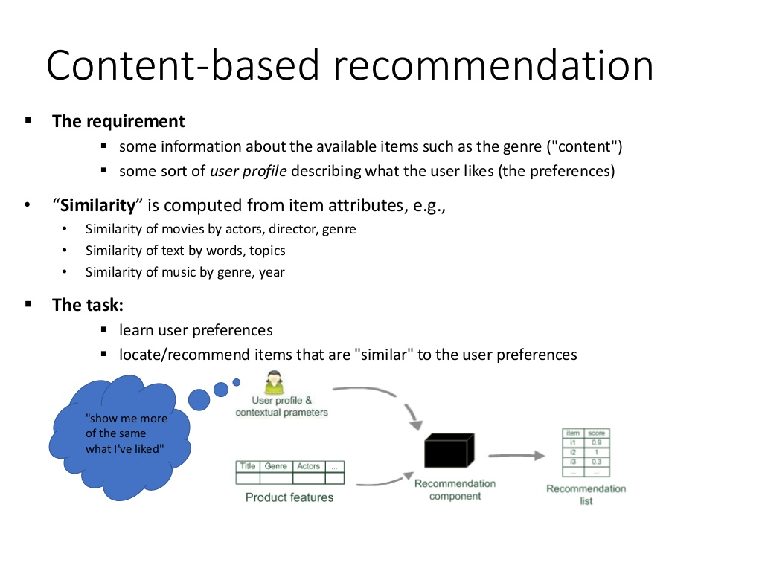
Content Based Recommendations

Slide 8
Advantages and Disadvantages OF Content-based Filtering
Advantages
The model doesn't need any data about other users, since the recommendations are specific to this user. This makes it easier to scale to a large number of users.
The model can capture the specific interests of a user, and can recommend niche items that very few other users are interested in.
Disadvantages
Since the feature representation of the items are hand-engineered to some extent, this technique requires a lot of domain knowledge. Therefore, the model can only be as good as the hand-engineered features.
The model can only make recommendations based on existing interests of the user. In other words, the model has limited ability to expand on the users' existing interests.

Slide 9
Collaborative Filtering

Slide 10
WHAT IS COLLABORATIVE FILTERING?
To recommend items via the choice of other similar users
it assumes that if user X and Y rate n items similarly or have similar behaviour, they will rate or act on other items similarly
The standard method of Collaborative Filtering is known as Nearest Neighbourhood algorithm
Instead of calculating the similarity between items, a set of ‘nearest neighbour’ users for each user whose past ratings have the strongest correlation are found. Therefore, scores for the unseen items are predicted based on a combination of the scores known from the nearest neighbours
divided into three subcategories: memory-based, model-based, and hybrid collaborative filtering

Slide 11
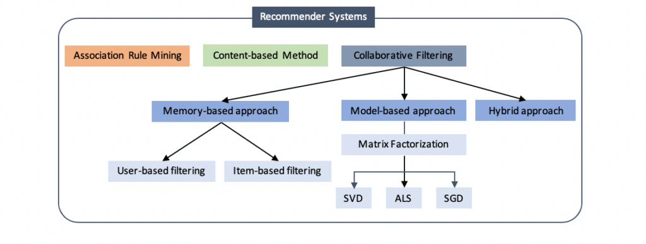
TYPES OF CF
1. MEMORY BASED APPROACH
A) for User-based CF We have an n × m matrix of ratings, with user uᵢ, i = 1, ...n and item pⱼ, j=1, …m. Now we want to predict the rating rᵢⱼ if target user i did not watch/rate an item j. The process is to calculate the similarities between target user i and all other users, select the top X similar users, and take the weighted average of ratings from these X users with similarities as weights.
some people tend to give high scores generally some are pretty strict even though they are satisfied with items. To avoid this bias, we can subtract each user’s average rating of all items when computing weighted average, and add it back for target user

Slide 12

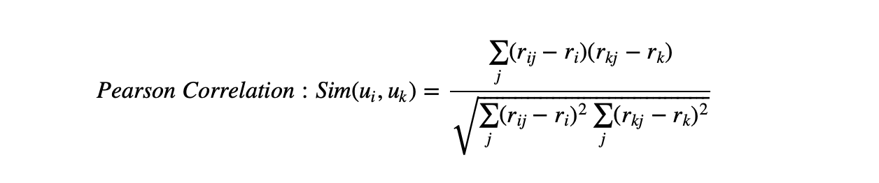
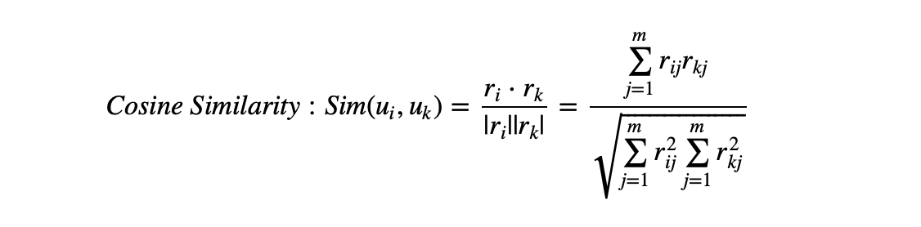
Two ways to calculate similarity are Pearson Correlation and Cosine Similarity.
Basically, the idea is to find the most similar users to your target user (nearest neighbours) and weight their ratings of an item as the prediction of the rating of this item for target user.
Without knowing anything about items and users themselves, we think two users are similar when they give the same item similar ratings .

Slide 13
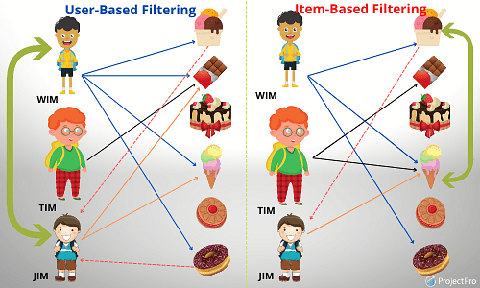
B)for Item-based CF, we say two items are similar when they received similar ratings from a same user. Then, we will make prediction for a target user on an item by calculating weighted average of ratings on most X similar items from this user.
advantage of Item-based CF is the stability which is that the ratings on a given item will not change significantly overtime, unlike the tastes of human beings

Slide 14
LIMITATIONS OF MEMORY BASED APPROACH
Popularity bias Generally, popular music can get more ratings. The music in long tail, however, can rarely get any. As a result, collaborative filtering mainly recommend the popular music to the listeners. Though giving popular items are reliable, it is still risky, since the user rarely get pleasantly surprised.
Cold start It is also known as data sparsity problems. At an early stage, few ratings is provided. Due to the lack of these ratings, prediction results are poor.
Human effort A perfect recommender system should not involve too much human efforts, since the users are not always willing to rate. The ratings may also grow towards those who do rate, but it may not be representative. Because of this absence of even distributed ratings, it can either give us false negative or false positive results.

Slide 15

2.MODEL BASED APPROACH
MATRIX FACTORISATION
Beside solving the issues of sparsity and scalability, it provides low-dimensional matrices to represent users’ preference
matrix factorization eventually gives us is how much a user is aligned with a set of latent features, and how much a movie fits into this set of latent features. The advantage of it over standard nearest neighbourhood is that even though two users haven’t rated any same movies, it’s still possible to find the similarity between them if they share the similar underlying tastes, again latent features.

Slide 16
To sort the values of Σ by decreasing absolute value and truncate matrix Σ to first k dimensions( k singular values), we can reconstruct the matrix as matrix A. The selection of k should make sure that A is able to capture the most of variance within the original matrix R, so that A is the approximation of R, A ≈ R
When matrix R is dense, U and V could be easily factorized analytically. However, a matrix of movie ratings is super sparse. Although there are some imputation methods to fill in missing values , we will turn to a programming approach to just live with those missing values and find factor matrices U and V. Instead of factorizing R via SVD, we are trying find U and V directly with the goal that when U and V multiplied back together the output matrix R’ is the closest approximation of R and no more a sparse matrix. This numerical approximation is usually achieved with Non-Negative Matrix Factorization for recommender systems since there is no negative values in ratings.

Slide 17
Cold Start Problem
Recommendation systems have a prevalent cold start problem. This problem is occurred might due to new users or new items are added into the system. The systems do not understand the new user’s preferences, therefore systems can not recommend the item to users.
In eCommerce there are two distinct categories of cold start:
New-User cold start
New-Item cold start

Slide 18
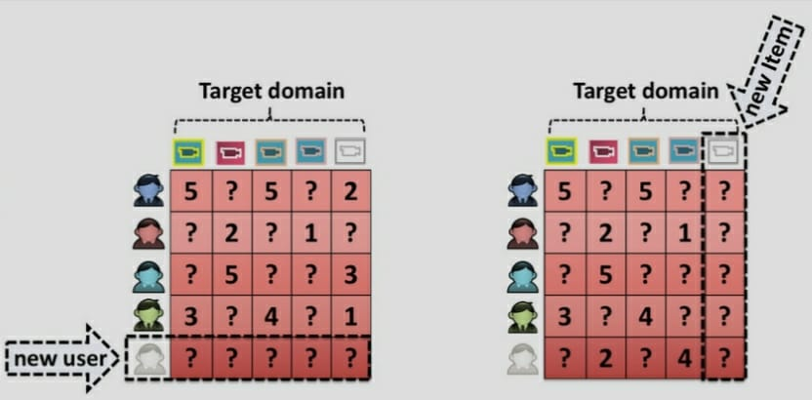

Slide 19
1.New user cold start
When system is not able to produce preferences for the new user due to lack of search history and rating information is called new-user cold start problem.
2. New item cold start
When it is not possible to place new items at the top of the preference list, is known as new item cold start problem.
Collaborative filtering is affected by the new user and new item cold-start problems, however the content-based recommendation suffers only from a new user cold start problem.

Slide 20
The solution (Approaches)
Researchers have purposed various ways to tackle the cold start problem:
1.Representative based: use subset of items and users that represent the population
2.Content based: use of side information such as text, social network, etc.
3. Bandit: consider the exploration vs exploitation tradeoff in new item.
4. Deep Learning: recent methods that tries to solve some issues tackled above but using a black box.

Slide 21
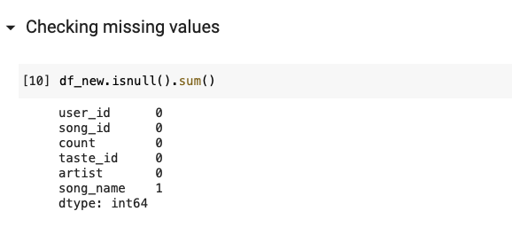
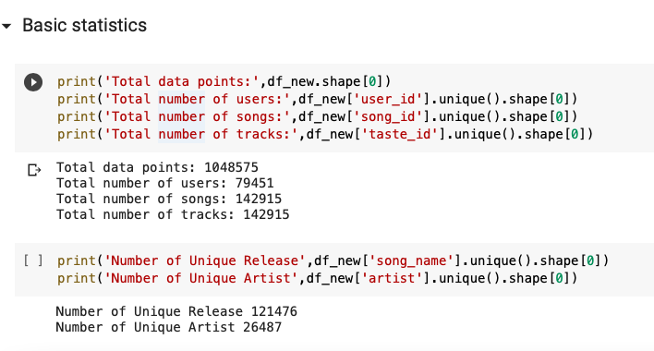
Exploratory Data Analysis
We have performed following steps to analyze the dataset:
Checking missing values 2. Descriptive Statistics

Slide 22
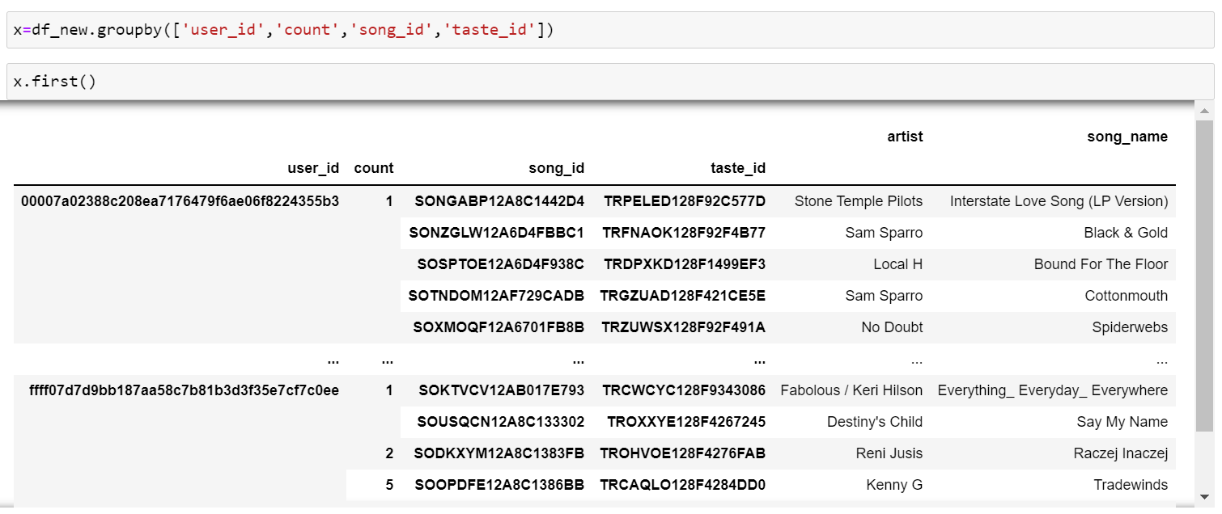
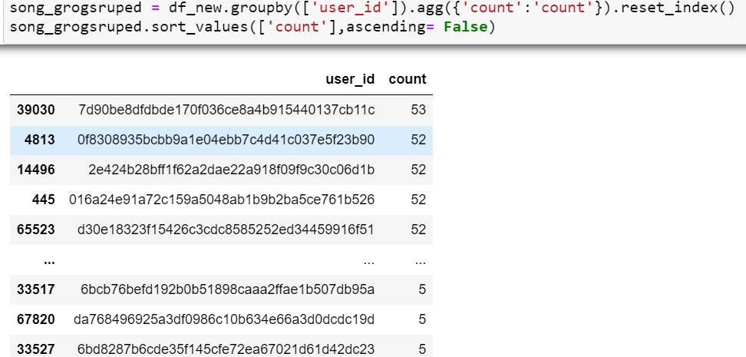
Analysis of User Id
In this analysis we find the
most user listened 53 tracks
And least active user listened
only five tracks
Total number of user is 79451

Slide 23
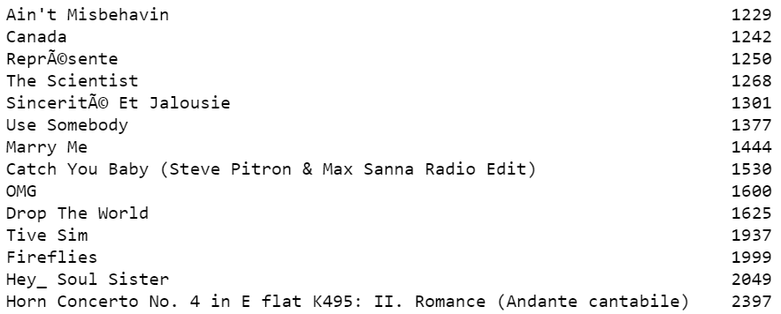
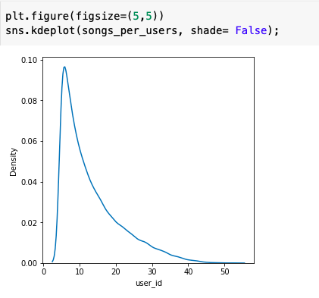
Analysis of Songs
It is the no of times each song played
Total no of new track released 142915 From this graph we observed that only
No of times songs streamed by users few songs is played most of the time.
is 3335779

Slide 24
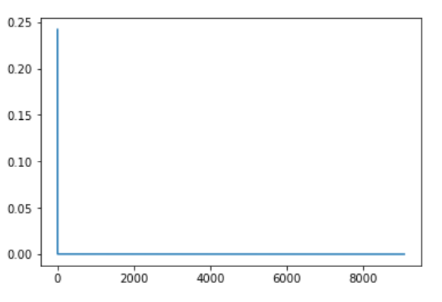
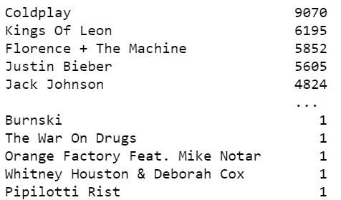
Analysis of Artists
Total no of unique artist in dataset is 26487
Pdf plot of artist
Most listened or popular artist in this playlist is coldplay
with 9070 streams.
There are 76 unique track of coldplay in this playlist

Slide 25
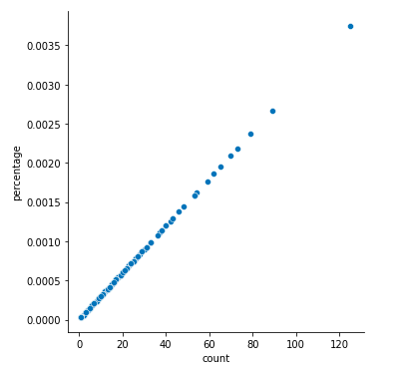
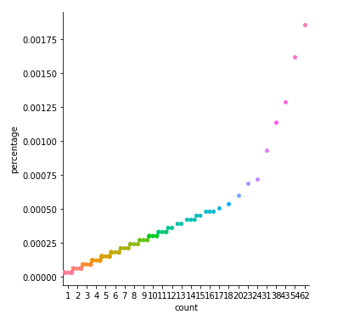
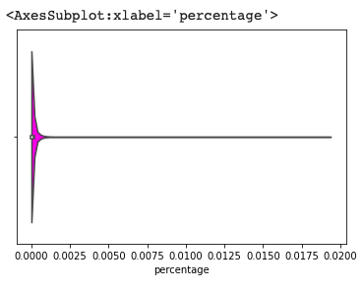
Visualization

Slide 26
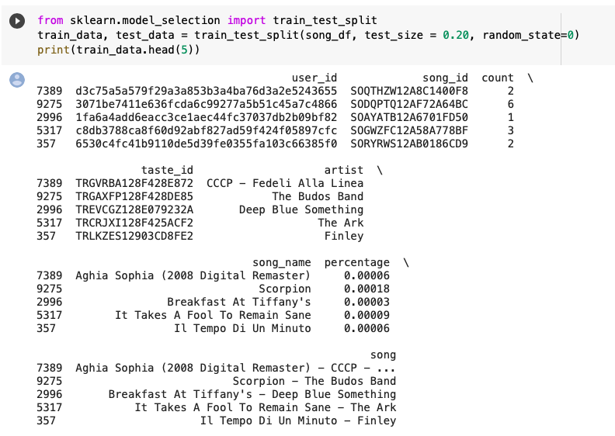
Recommendation System
Create a song recommender:

Slide 27
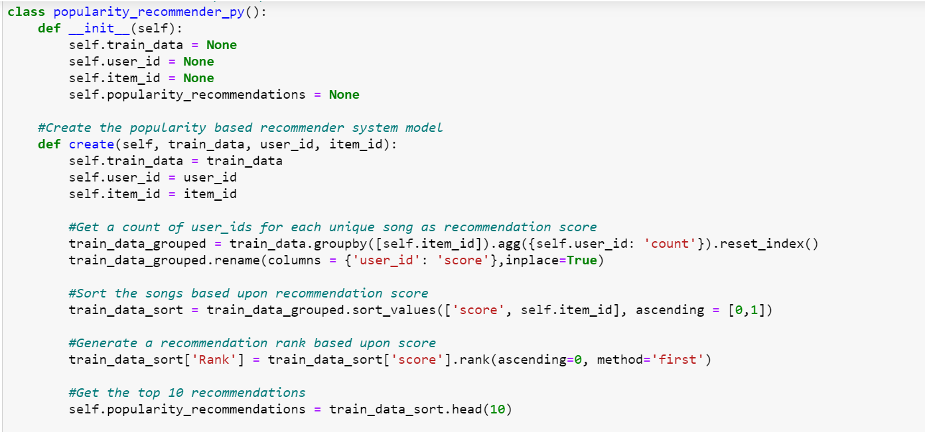
POPULARITY BASED
Class initiated with their members
Member gets defined here
Popularity wise songs get arranged here

Slide 28
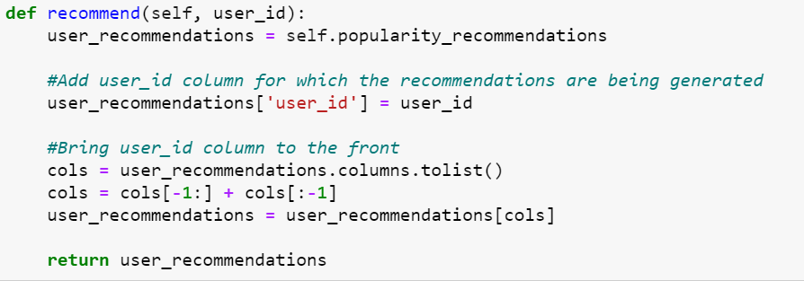

Slide 29
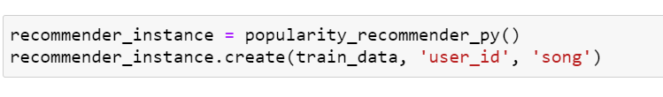
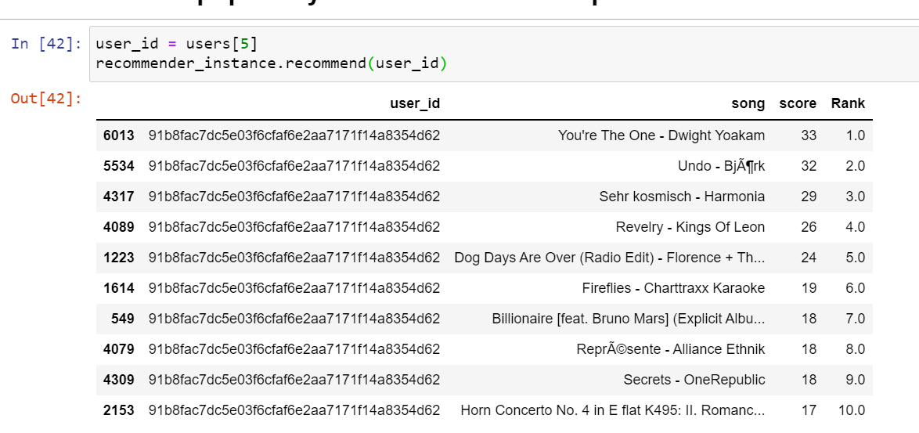

Slide 30
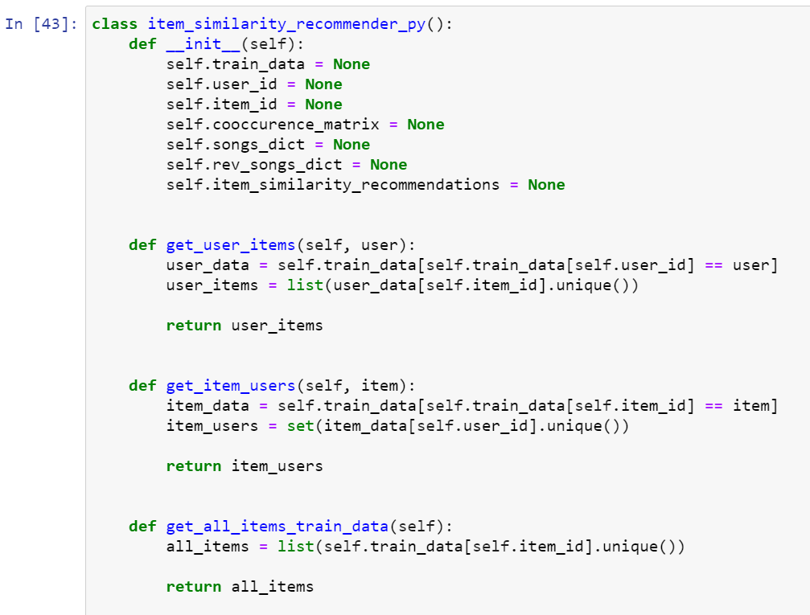
Collaborative Filtering
CREATE CLASS AND MEMBERS
Get unique items (songs) corresponding to a given user
Get unique users for a given item (song)
Get unique items (songs) in the training data

Slide 31
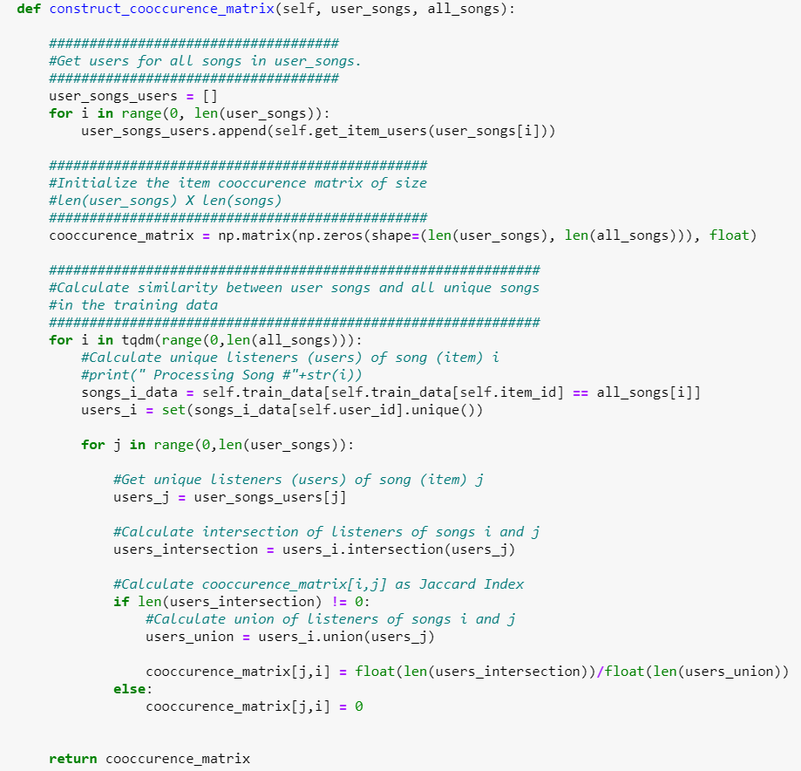

Slide 32
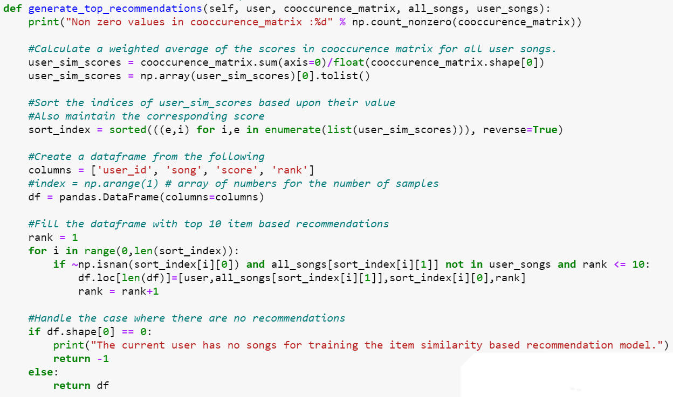

Slide 33
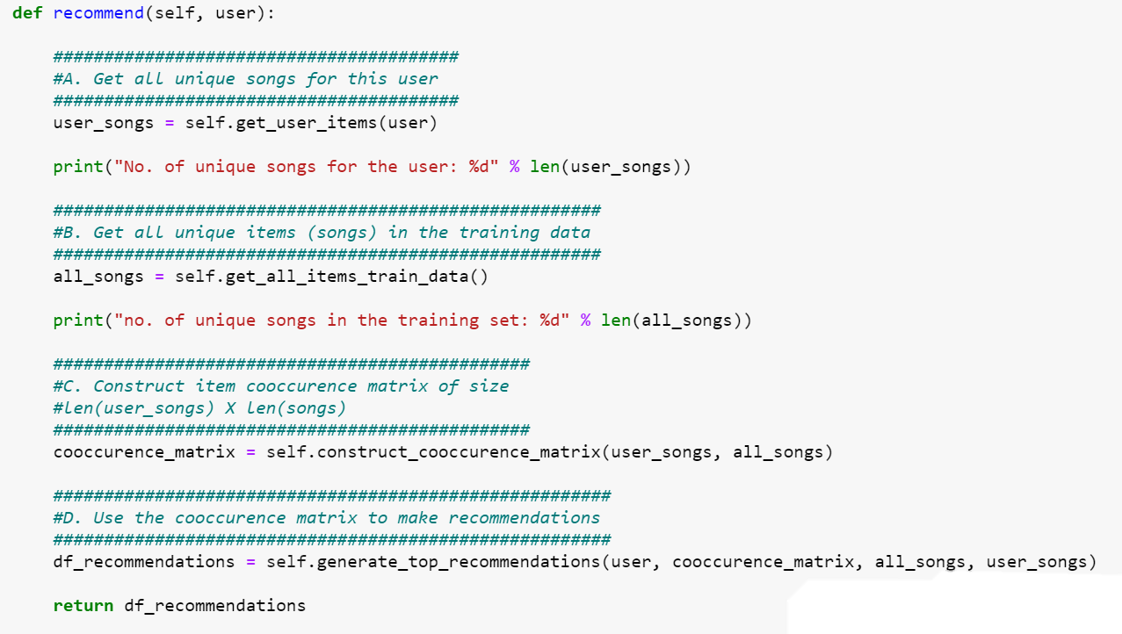

Slide 34
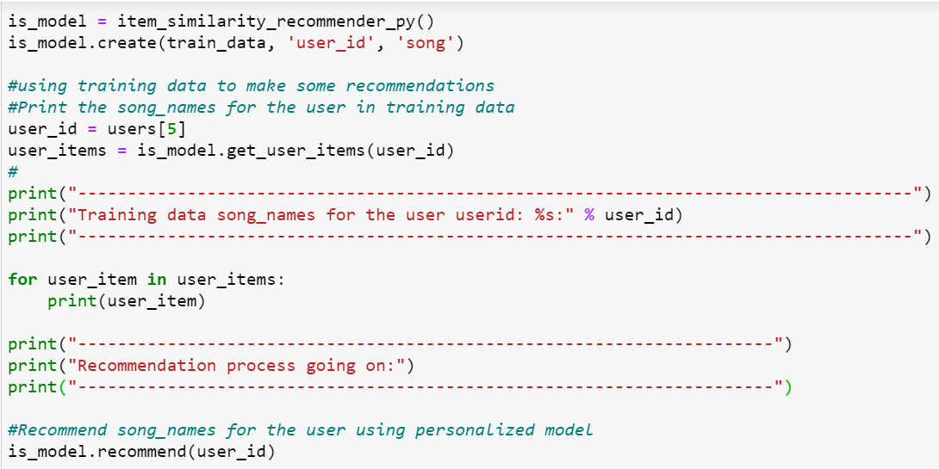

Slide 35
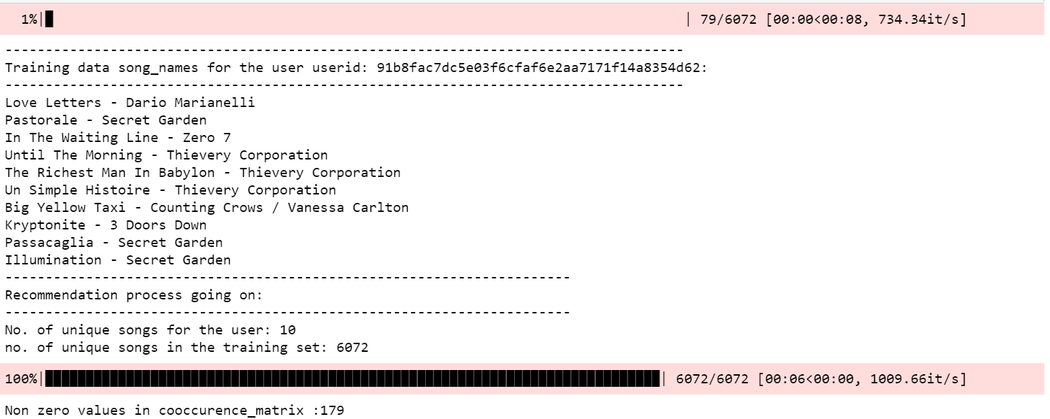
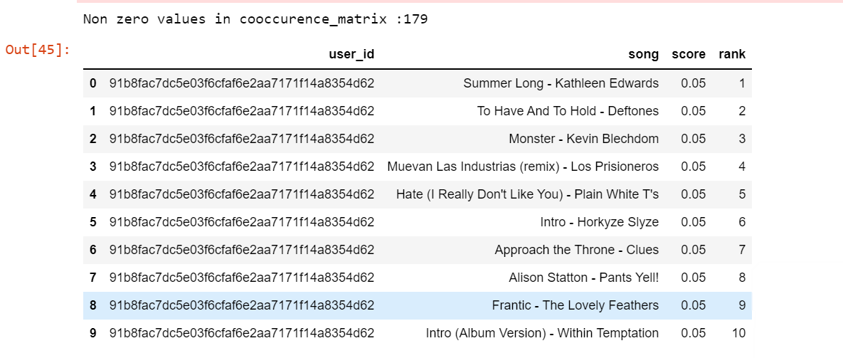

Slide 36
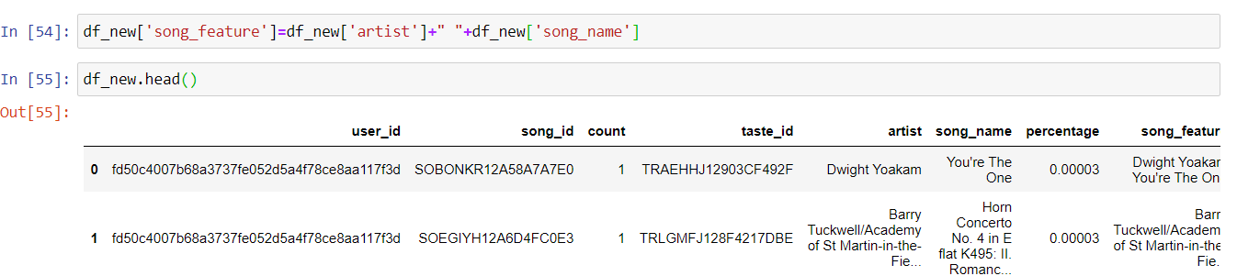
Content Based Filtering
Content-based systems make recommendations based on the user’s purchase or consumption history and generally become more accurate the more actions (inputs) the user takes.
First we have create another column in which we store
artist_name + song_name = song_feature .

Slide 37
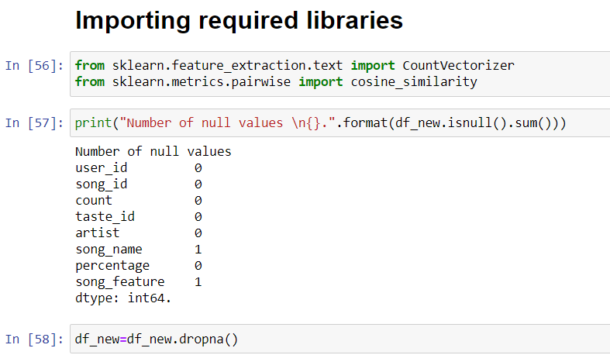
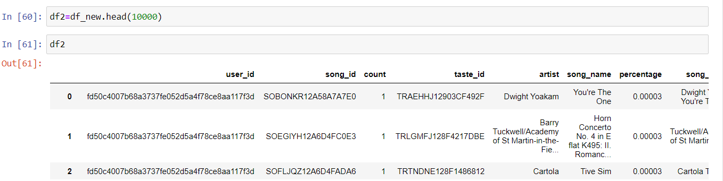
→Importing all the required library . →Check is there is null value exist in the dataset . →Drop all rows in which null value exist .
→ We had millions of data set so we have to take only 10000 rows.

Slide 38
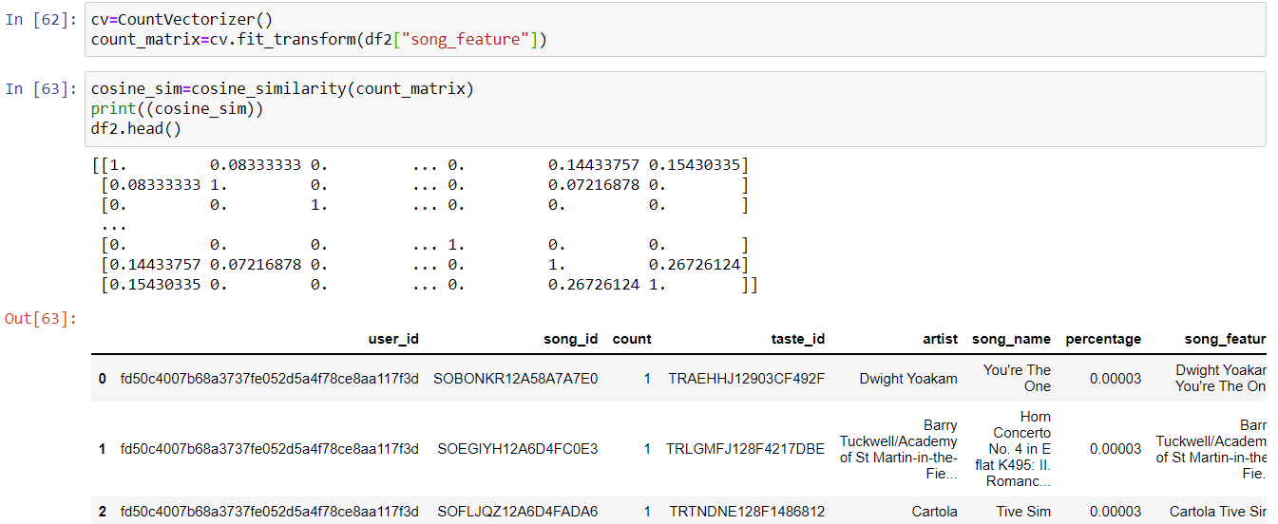
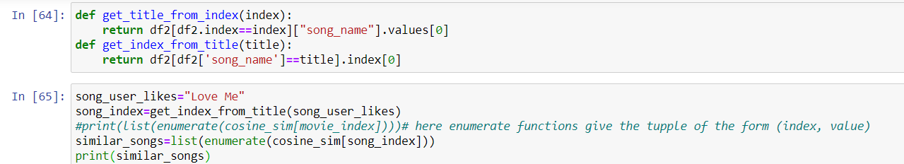
→ Here we use the count vectorizer function to fit the data of song_feature column into matrix form. → And use the cosine similarity function on count matrix .
→Now we define two function get_title_from_index
And get_index_from_title
→After that we give the name of the song that user likes and list of similar song is created

Slide 39
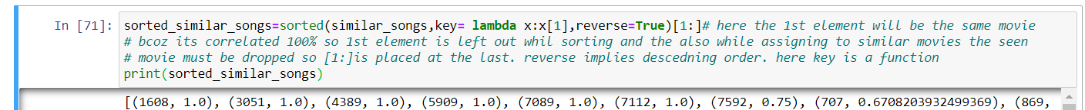
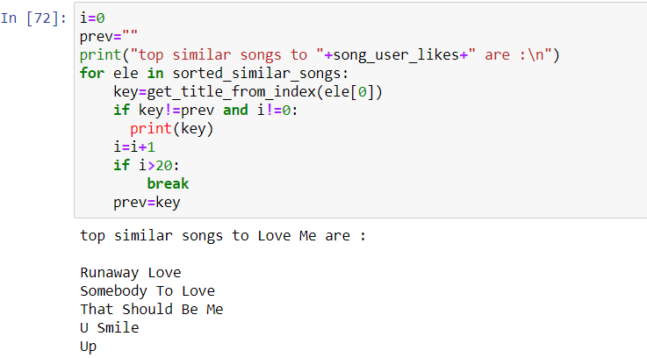
Here we use the for loop until we find the similar song to song_user_likes .

Slide 40
FUTURE SCOPE
In the future, we would like to try the following things:
1.Using audio signal (e.g. audio frequency) to recommend songs
2.Trying content based algorithm
3.Trying Convolutional Neural Network
4.Making the recommender system a real-time system
5.Trying clustering techniques to recommend music
By thinking about affective and social data, emotion based model and context based model generally improved the standard of exhortation.
The approaches like collaborative filtering, content-based filtering, singular value decomposition (SVD) and factorization machines (FM) are also used. At last, the proposed system is hybridized by using SVD and FM.

Slide 41

THANK YOU

